Slide 1
Wellington Starting at 9:30

Slide 2
Keynote + Dataverse
Rami Mounla

Slide 3

Speakers
Aung Khaing
Custom Connectors
Aung Khaing
Canvas
Rami Mounla
Dataverse
Linn Zaw Win
Power Automate
Shobhit Bhatnagar
ChatGPT
Mary Ann Castro
AI Builder
3

Slide 4

Event Sponsors

Slide 5
Agenda
9:30 Keynote and introductions 10:00 Dataverse, setting up your schema and model-driven apps - Rami 10:50 AI Builder for sentiment analysis - Mary Ann Castro 11:40 Custom Connectors to Speech to Text - Aung Khaing 12:30 Lunch Break 13:30 Integrate with Power Automate - Linn Zaw Win 14:20 Display with Canvas App - Abhay Mishra 15:10 Sentiment Analysis with ChatGPT - Shobhit Bhatnagar 16:00 Closing

Slide 6
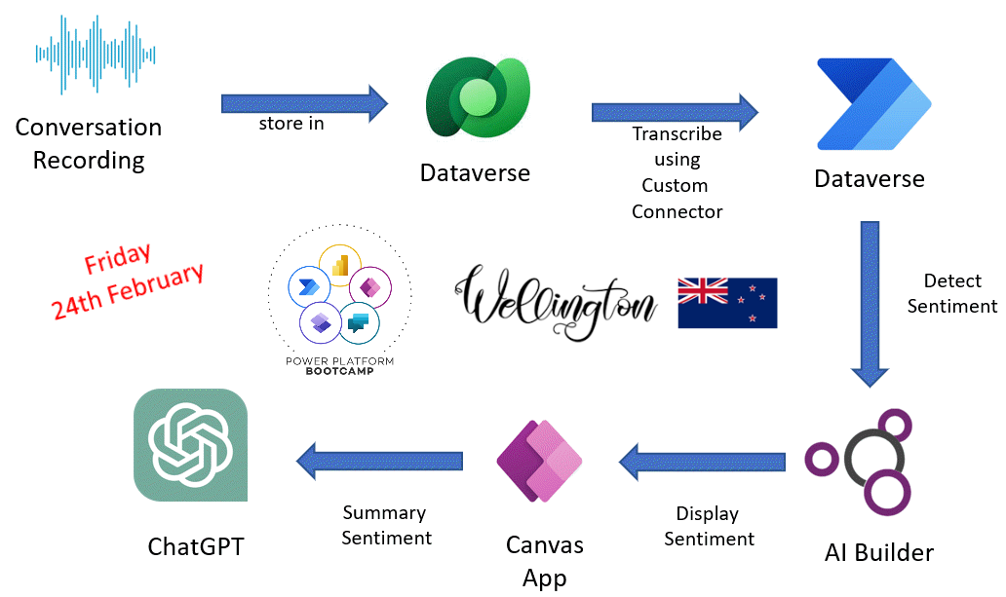

Slide 7
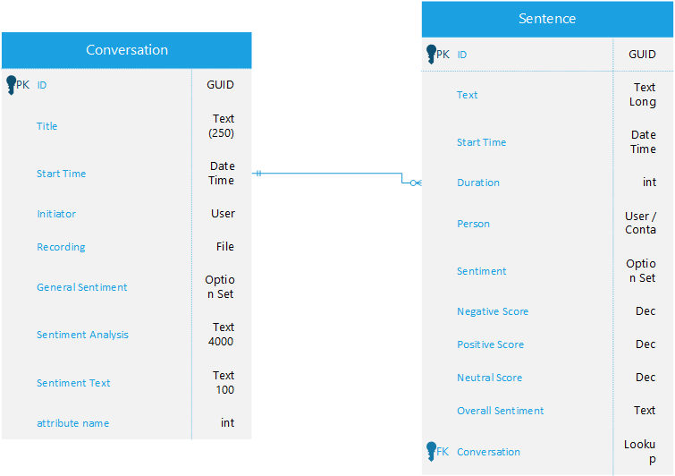
Dataverse

Slide 8
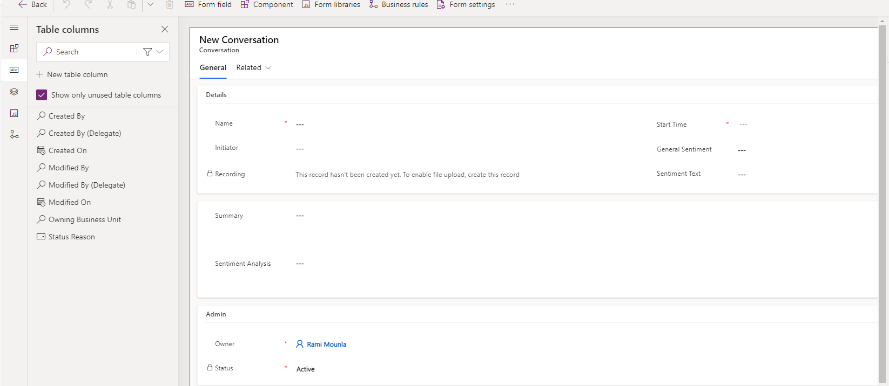
Conversation Form

Slide 9
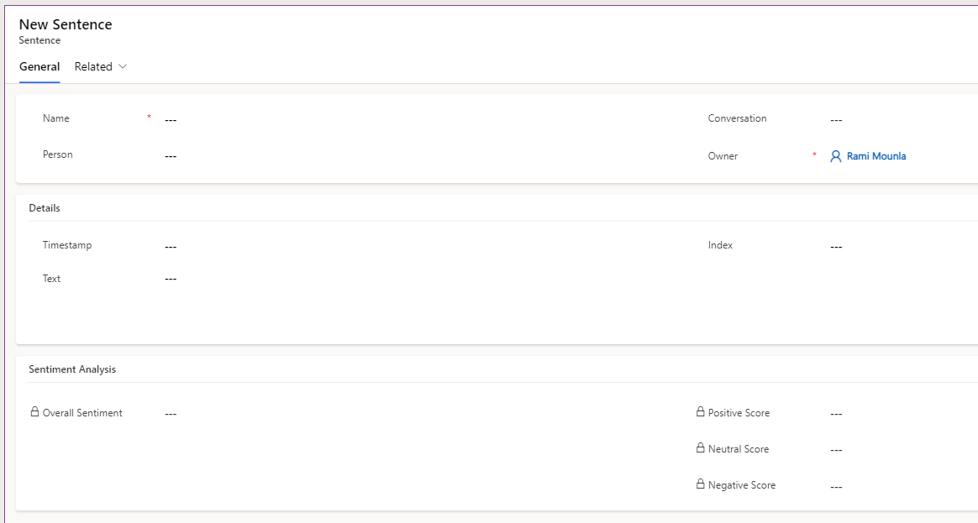
Sentence Form

Slide 10
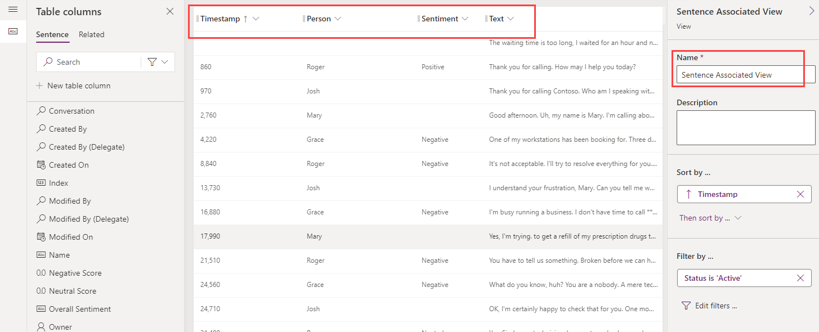
Sentence View

Slide 11
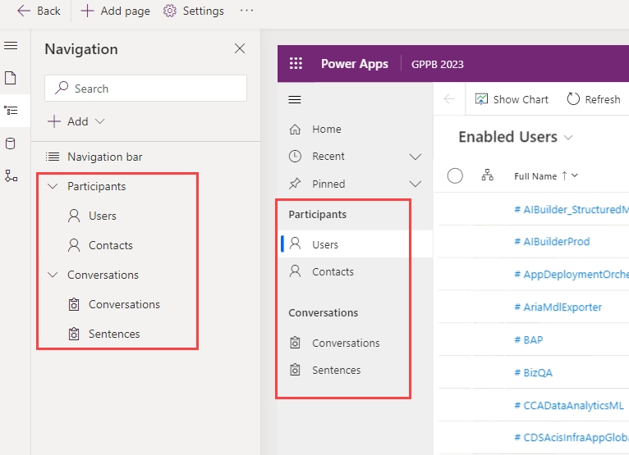
Model Driven

Slide 12
Any Questions?

Slide 13
Thank you
Resources:
13

